Slide 1
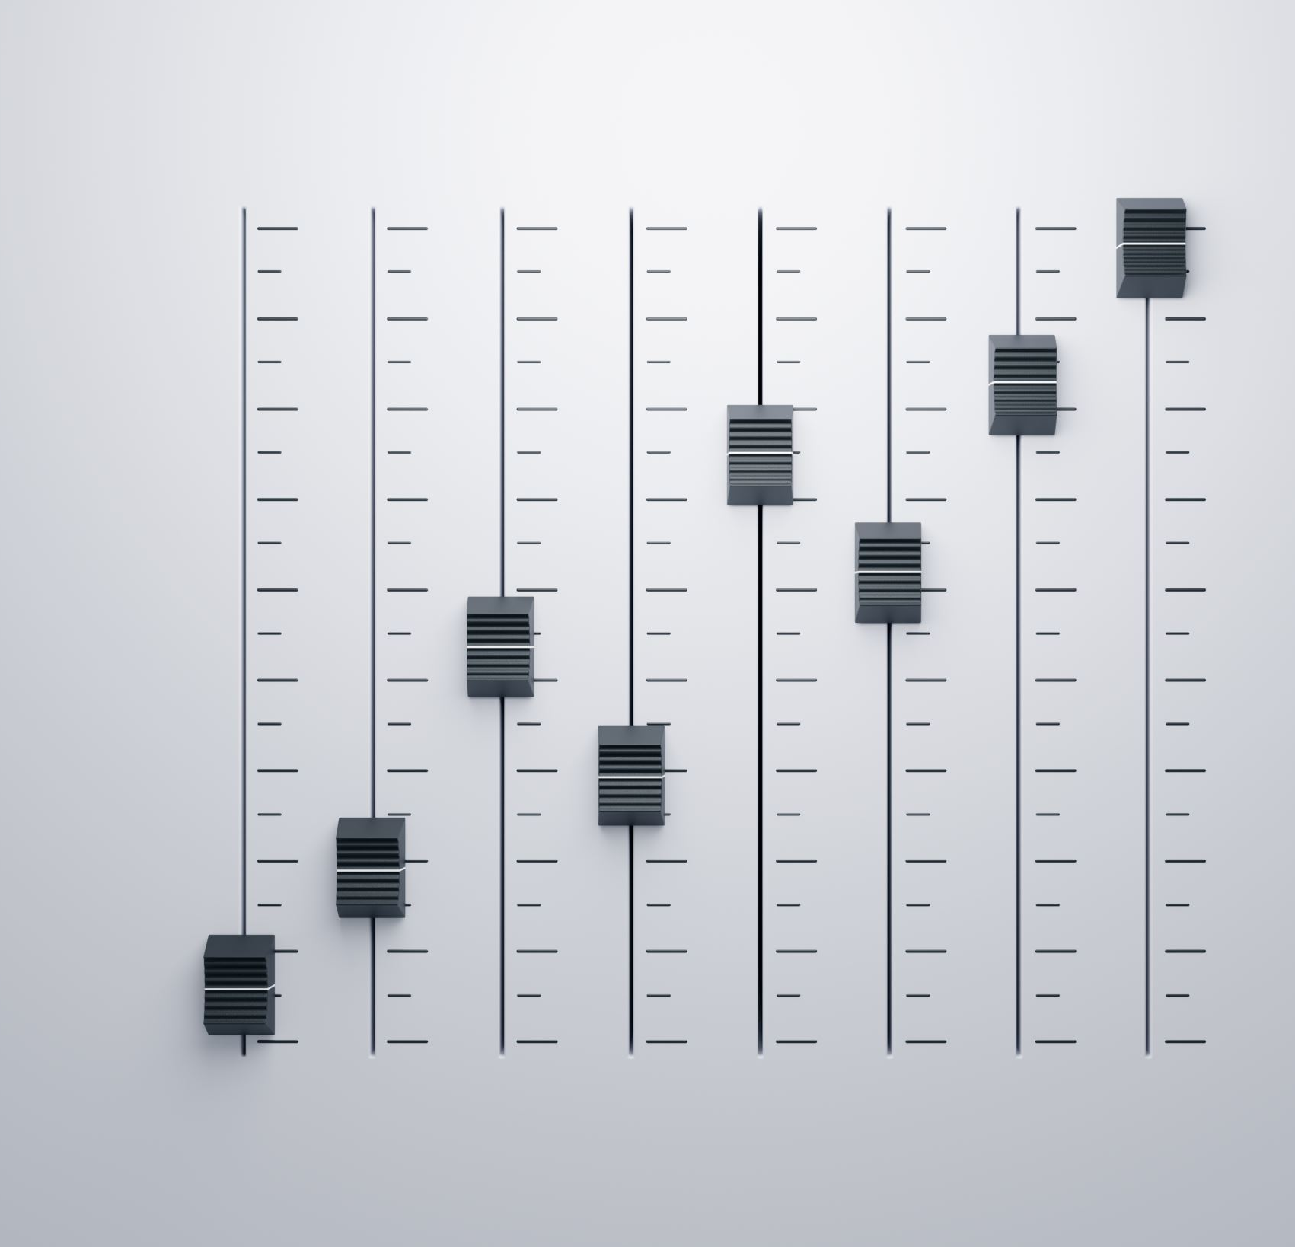
Feature Selection Methods for Music Genre Classification Models
Anshul Hallur

Slide 2

Introduction
Classifying music is still an ongoing process that has not been perfected.
Music Genre Classification models analyze various features of the music and identify patterns that are representative of a particular genre.
Problems to solve in current models include:
Subjective evaluation of the genre
Not able to keep up with new genres
Not identifying the correct features

Slide 3
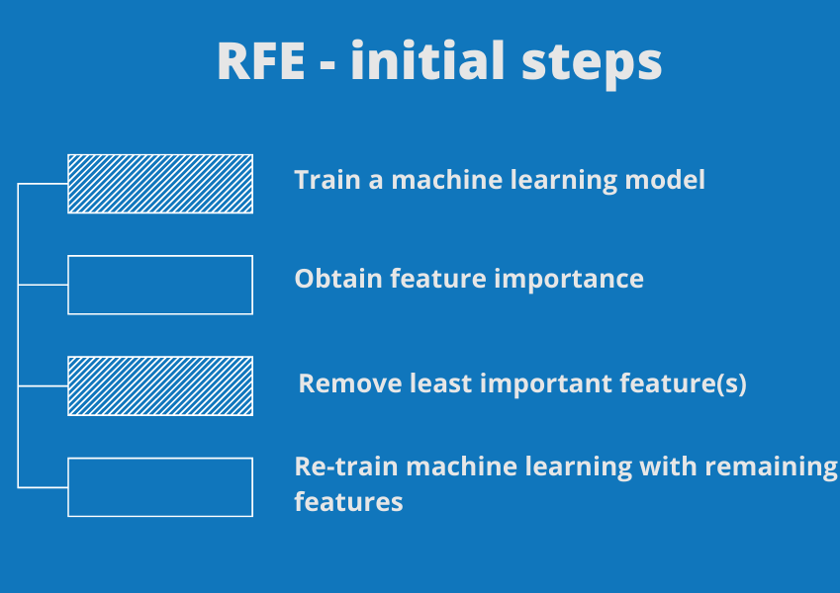
Introduction cont’d.
Previous research explored three main approaches to music genre classification :-
Content based traditional machine learning models
CNN’s
RNN’s
Feature selection methods such as RFE and Boruta help identify important underlying features and help in reducing the number of features and selecting the most relevant ones.

Slide 4
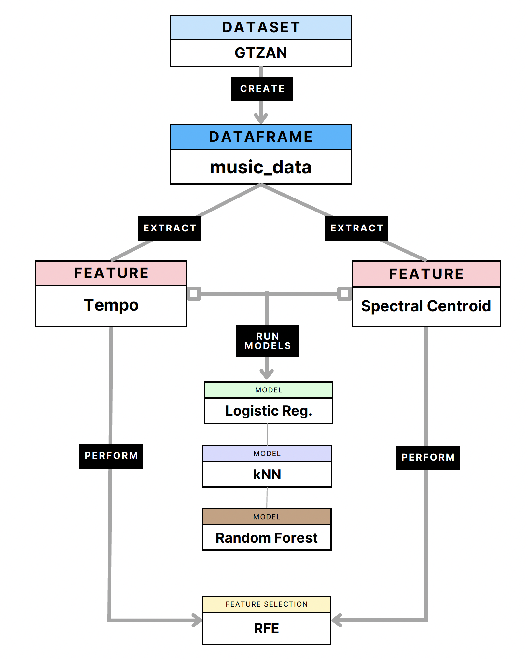
Methods and Materials
Download GTZAN dataset
Create "music_data" dataframe and extract tempo and spectral centroid features
Run models Logistic Regression, Random Forest, k-Nearest Neighbors (kNN)
Perform RFE using random forest model for tempo and spectral centroid features.

Slide 5
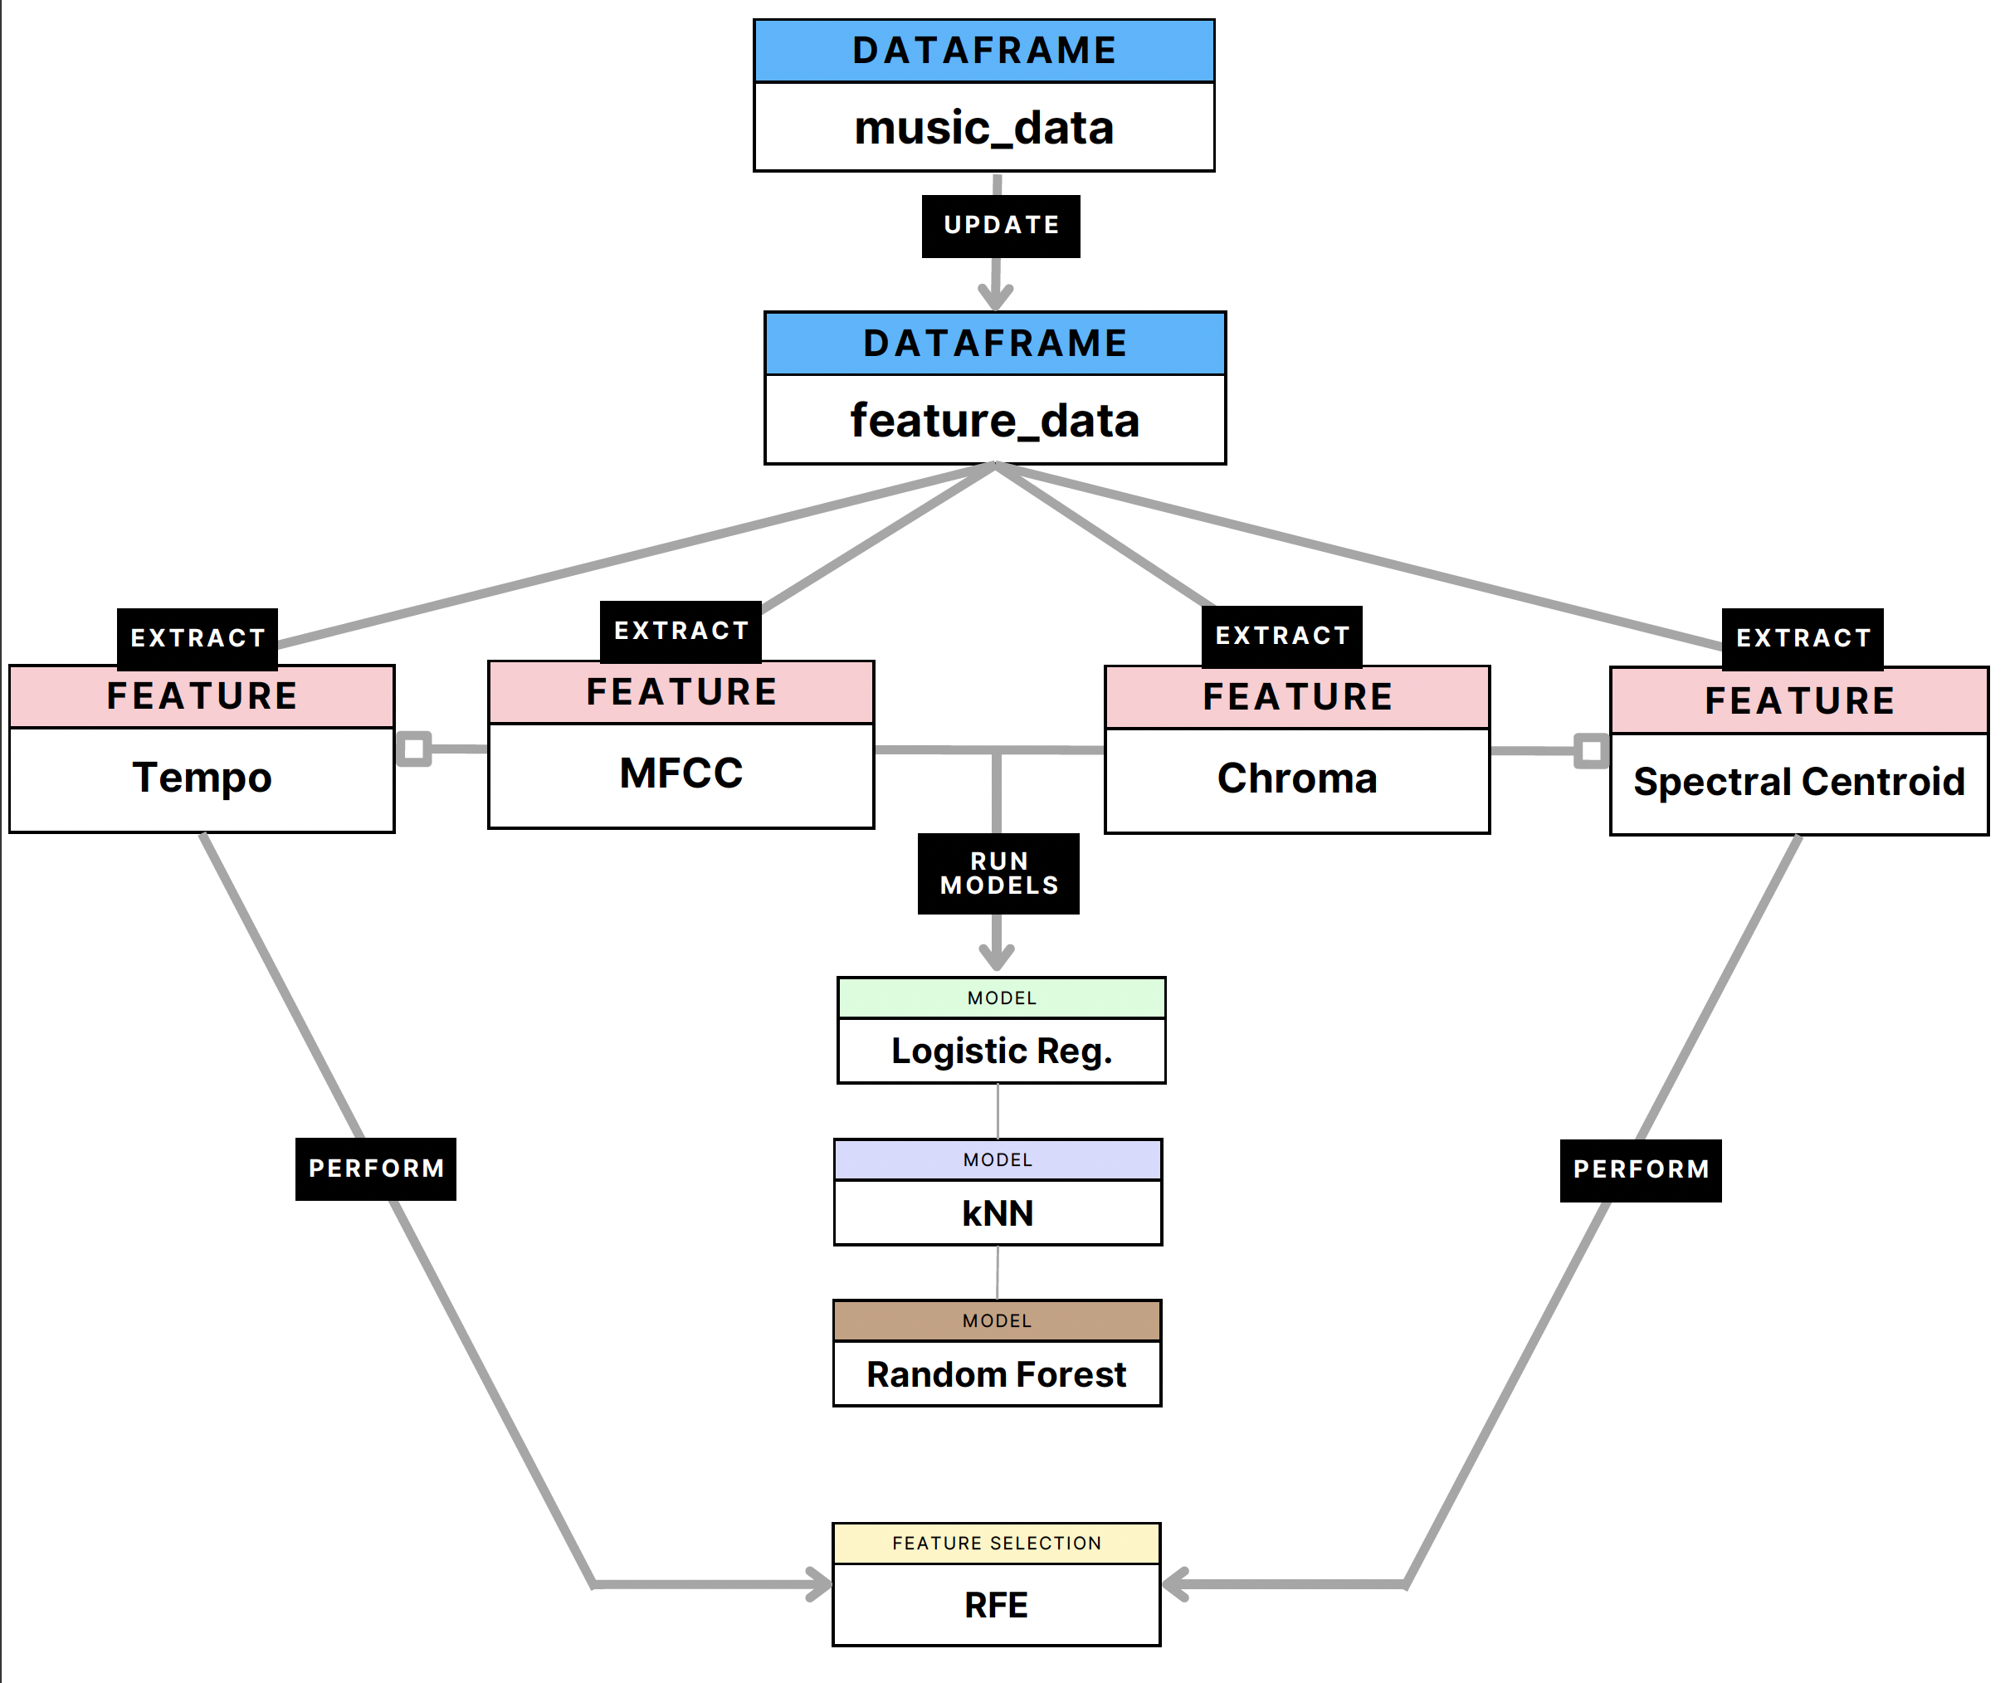
Methods cont’d.
Incorporate MFCC and Chroma features
Calculate MFCC and Chroma features
Add features to feature_data
Perform RFE with MFCC and Chroma features

Slide 6
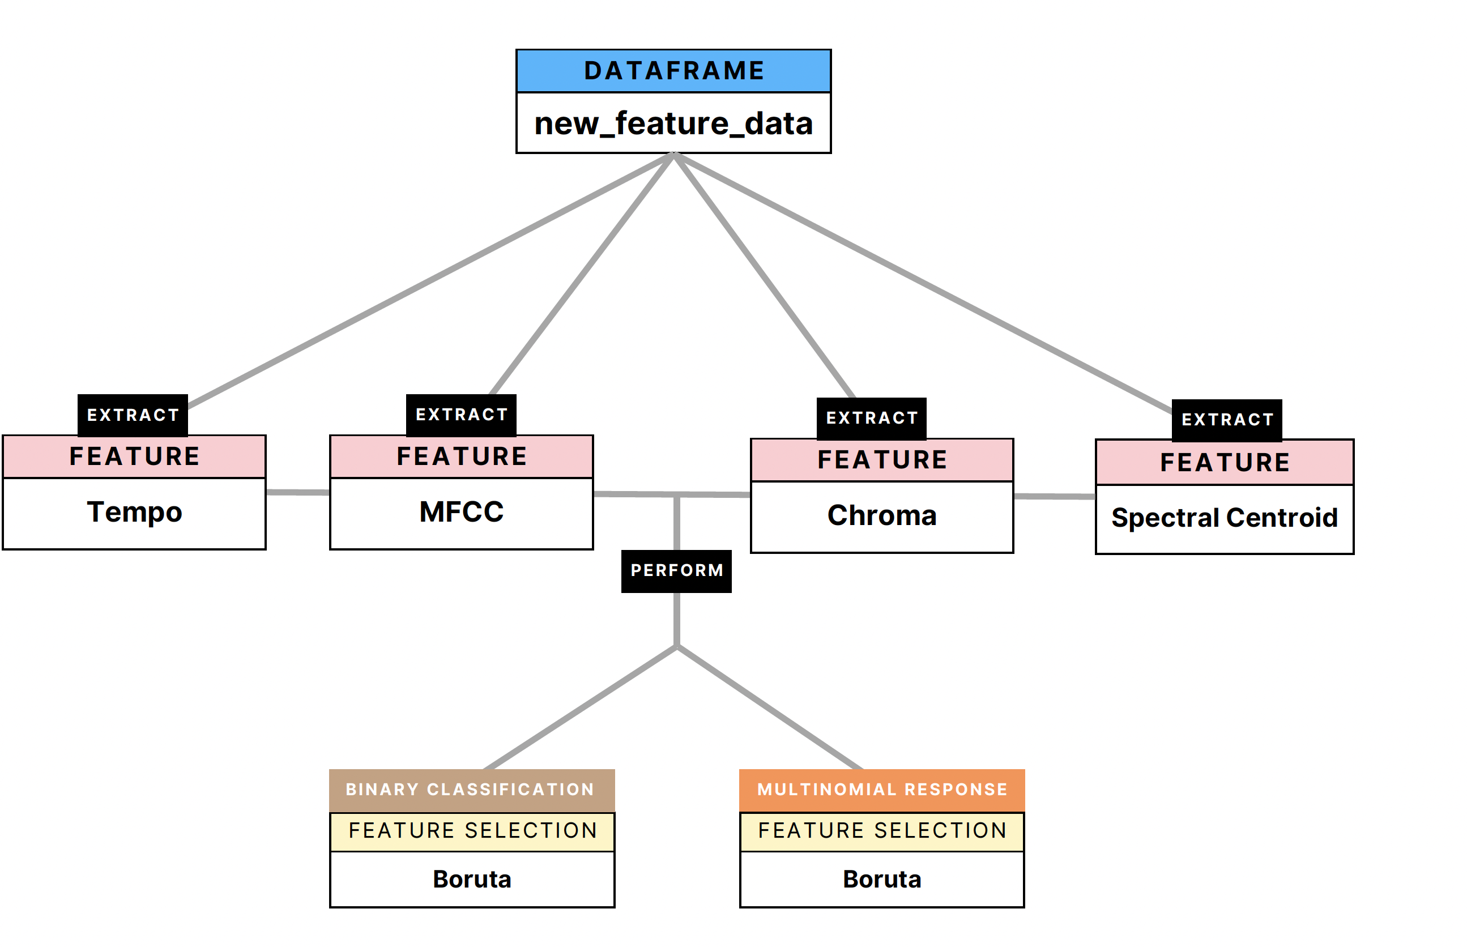
Methods cont’d.
Split updated data into training and test sets (70/30)
Train and evaluate models again with MFCC and Chroma features
Create "new_feature_data" dataframe
Perform Boruta feature selection

Slide 7
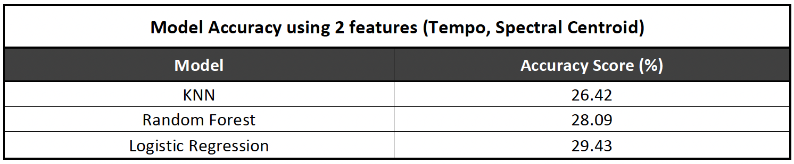
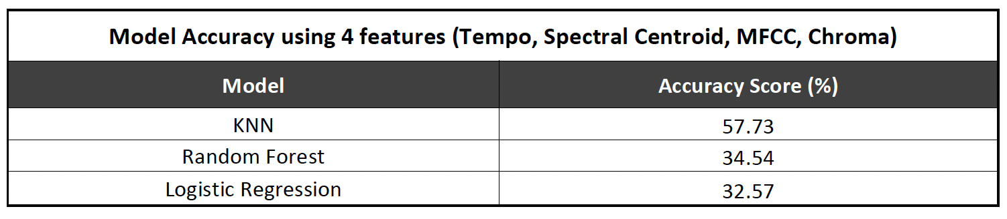
Results

Slide 8
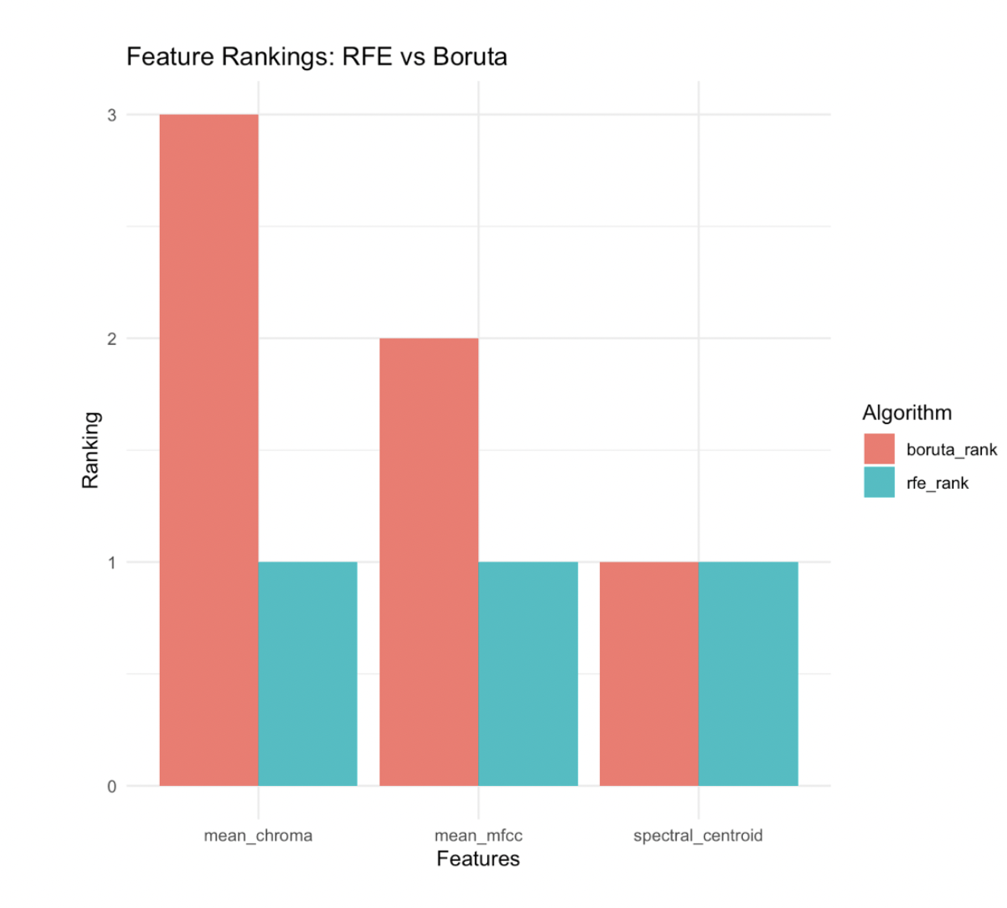
Results cont’d.
Boruta method deemed “tempo” as unimportant
Boruta method highlighted mean_chroma, mean_mfcc, and spectral_centroid as important
”Spectral Centroid” feature importance consistent with both methods

Slide 9
Discussion
Main takeaways
Addition of MFCC and Chroma improved performance of all 3 models
Boruta method was more consistent with our initial results of model performance.
Compared to similar studies, kNN performance achieved similar accuracy

Slide 10
Discussion cont’d.
Feature Selection
Tempo: Measures the speed or pace of an audio file
Spectral Centroid: Distinguishes between different types of bright or dull sounds
MFCC : Short-term spectral shape of a sound signal
Chroma : The pitch content of a sound signal in audio files

Slide 11
Discussion cont’d.
Limitations
Large dataset (computationally expensive)
Extraction process included limited set of features
Imputation methods instead of using “na.omit”
Include hyperparameter tuning
Ensemble methods could improve performance
Use advanced techniques, such as deep learning

Slide 12
Conclusion
Feature selection methods help identify relevant and important features
Addition of MFCC and Chroma features improve model
RFE and Boruta methods can be used to create better predicitons for classifying music

Slide 13

Thank you for listening!

